Slide 1
Multidimensional Arrays and Image Manipulation
Eric Roberts
CS 106A
February 17, 2010

Slide 2
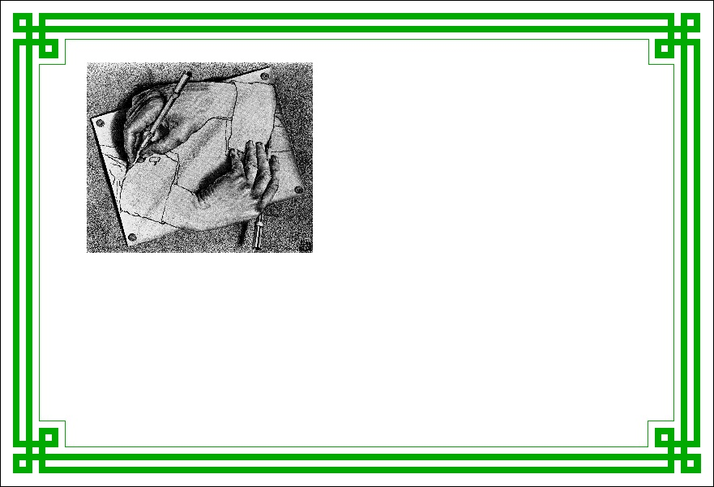
Graphics Contest Results
The CS106A
Graphics Contest
February 2010

Slide 3
Graphics Contest Results
Best in show:
Joseph Victor, Fractal Bop
First place (algorithmic):
Dustin Janatpour, Ball Pit
Runner-up (algorithmic):
Thomas Davids, Baseball
Runner-up (algorithmic):
Austin Hulse, Ocean Cliff
First place (aesthetic):
Caroline Shen, Egg Adoption Center
Runner-up (aesthetic):
Dustin Janatpour, Ball Pit
Runner-up (aesthetic):
Michael Greer, Tricky Fixie
Runner-up (aesthetic):
Austin Hulse, Ocean Cliff
Honorable mention:
Angela Hayes, Fountain Hopping
Honorable mention:
Hong Jang, Pong
Honorable mention:
William Monroe IV, Egyptian Rat Screw
Honorable mention:
Jon Rodriguez, BreakIn

Slide 4




Class Standings
35/58
0.60
19/39
0.49
22/39
0.56
20/58
0.34
28/73
0.38
19/73
0.26
9/48
0.19
6/48
0.13
Freshman
Sophomore
Junior
Senior

Slide 5
Multidimensional Arrays and Image Manipulation

Slide 6
In Our Last Episode . . .
In last week’s section, you were asked to assume the existence of a method
double[] readScoresArray(String filename)
that reads score data from the specified file, one value per line, and returns an array of doubles containing those values.
Before we start on today’s topic, I want to finish this exercise so that you have another code example for working with files.

Slide 7
Multidimensional Arrays
Because the elements of an array can be of any Java type, those elements can themselves be arrays. Arrays of arrays are called multidimensional arrays.
In Java, you can create a multidimensional array by using multiple brackets in both the type and the initialization parts of the declaration. For example, you can create array space for a 3 ^{x} 3 tic-tac-toe board using the following declaration:
char[][] board = new char[3][3];
This declaration creates a two-dimensional array of characters that is organized like this:
board[0][0]
board[0][1]
board[0][2]
board[1][0]
board[1][1]
board[1][2]
board[2][0]
board[2][1]
board[2][2]

Slide 8


Multidimensional Arrays and Images
One of the best examples of multidimensional arrays is a Java image, which is logically a two-dimensional array of pixels.
Consider, for example, the logo for the Java Task Force at the top right. That logo is actually an array of pixels as shown in the expanded diagram at the bottom.
The GImage class allows you to convert the data for the image into a two-dimensional array of pixel values. Once you have this array, you can work with the data to change the image.

Slide 9
Pixel Arrays
If you have a GImage object, you can obtain the underlying pixel array by calling the getPixelArray, which returns a two-dimensional array of type int.
For example, if you wanted to get the pixels from the image file JTFLogo.gif, you could do so with the following code:
GImage logo = new GImage("JTFLogo.gif");
int[][] pixels = logo.getPixelArray();
The first subscript in a pixel array selects a row in the image, beginning at the top. The height of the image is therefore given by the expression pixels.length.
The second subscript in a pixel array selects an individual pixel within a row, beginning at the left. You can use the expression pixels[0].length to determine the width of the image.

Slide 10
Pixel Values
Each individual element in a pixel array is an int in which the 32 bits are interpreted as follows:
1
1
1
1
1
1
1
1
1
0
0
1
1
0
0
1
0
1
1
0
0
1
1
0
0
0
1
1
0
0
1
1
transparency (α)
red
green
blue
The first byte of the pixel value specifies the transparency of the color, which is described in more detail on the next slide.
The next three bytes indicate the amount of red, green, and blue in the pixel, in which each value varies from 0 to 255. Together, these three bytes form the RGB value of the color, which is typically expressed using six hexadecimal digits. The color in the example has the RGB value 0x996633, which is a light brown:

Slide 11

Transparency
The first byte of the pixel value specifies the transparency of the color, which indicates how much of the background shows through. This value is often denoted using the Greek letter alpha (α).
Transparency values vary from 0 to 255. The value 0 is used to indicate a completely transparent color in which only the background appears. The value 255 indicates an opaque color that completely obscures the background. The standard color constants all have alpha values of 255.
Fully transparent colors are particularly useful in images, because they make it possible to display images that do not have rectangular outlines. For example, if the gray pixels in the corners of the JTFLogo.gif image have an alpha value of 0, the background will show through those parts of the logo.

Slide 12
Image Manipulation
You can use the facilities of the GImage class to manipulate images by executing the following steps:
1.
Read an existing image from a file into a GImage object.
2.
Call getPixelArray to get the pixels.
3.
Write the code to manipulate the pixel values in the array.
4.
Call the GImage constructor to create a new image.
The program on the next slide shows how you can apply this technique to flip an image vertically. The general strategy for inverting the image is simply to reverse the elements of the pixel array, using the same technique as the reverseArray method on an earlier slide.

Slide 13
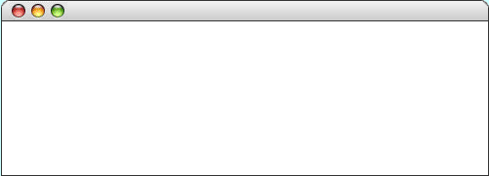
The FlipVertical Program
public void run() {
GImage original = new GImage("Candle.gif");
GImage flipped = flipVertical(original);
double y = (getHeight() - original.getHeight()) / 2;
double x1 = (getWidth() - IMAGE_SEP) / 2;
double x0 = x1 - original.getWidth() - IMAGE_SEP;
add(original, x0, y);
add(flipped, x1, y);
}
public void run() {
GImage original = new GImage("Candle.gif");
GImage flipped = flipVertical(original);
double y = (getHeight() - original.getHeight()) / 2;
double x1 = (getWidth() - IMAGE_SEP) / 2;
double x0 = x1 - original.getWidth() - IMAGE_SEP;
add(original, x0, y);
add(flipped, x1, y);
}
private GImage flipVertical(GImage image) {
int[][] array = image.getPixelArray();
int height = array.length;
for (int p1 = 0; p1 < height / 2; p1++) {
int p2 = height - p1 - 1;
int[] temp = array[p1];
array[p1] = array[p2];
array[p2] = temp;
}
return new GImage(array);
}
private GImage flipVertical(GImage image) {
int[][] array = image.getPixelArray();
int height = array.length;
for (int p1 = 0; p1 < height / 2; p1++) {
int p2 = height - p1 - 1;
int[] temp = array[p1];
array[p1] = array[p2];
array[p2] = temp;
}
return new GImage(array);
}
flipped
original
x0
x1
y
array
array
image
image
164
305
24
height
height
100
100
FlipVertical
skip simulation

Slide 14
Selecting Color Components
If you want to work with the colors of individual pixels inside a pixel array, you can adopt either of two strategies:
  You can use the bitwise operators described in the text to select or change individual bits in the pixel value.
  You can use the static methods provided by the GImage class for that purpose.
Although it is useful to remember that all information is stored as bits, there doesn’t seem to be much point in going into all the details, at least in CS 106A. We will therefore use the second strategy and employ the static methods getRed, getGreen, getBlue, getAlpha, and createRGBPixel.
The definitions of these methods (along with the underlying implementations, which you are free to ignore) are shown on the next slide.

Slide 15
Static Methods in GImage
/** Returns the alpha component from an RGB value. */
public static int getAlpha(int pixel) {
return (pixel >> 24) & 0xFF;
}
/** Returns the red component from an RGB value. */
public static int getRed(int pixel) {
return (pixel >> 16) & 0xFF;
}
/** Returns the green component from an RGB value. */
public static int getGreen(int pixel) {
return (pixel >> 8) & 0xFF;
}
/** Returns the blue component from an RGB value. */
public static int getBlue(int pixel) {
return pixel & 0xFF;
}
/** Creates an opaque pixel value from the color components */
public static int createRGBPixel(int r, int g, int b) {
return createRGBPixel(r, g, b, 0xFF);
}
/** Creates a pixel value from the color components, including alpha */
public static int createRGBPixel(int r, int g, int b, int alpha) {
return (alpha << 24) | (r << 16) | (g << 8) | b;
}

Slide 16
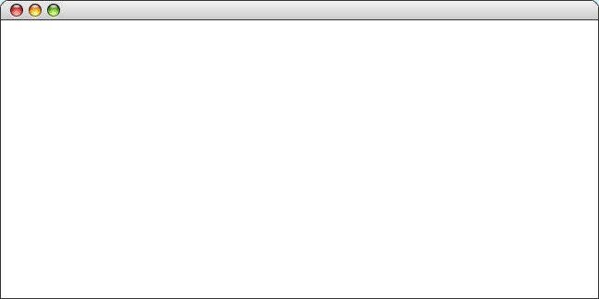
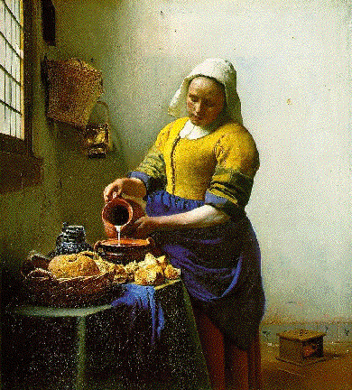
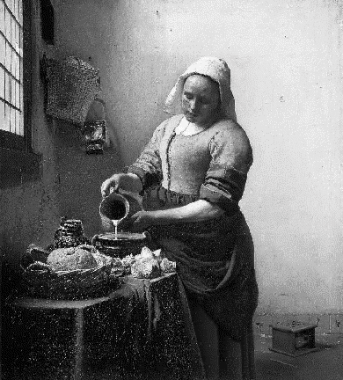
Creating a Grayscale Image
As an illustration of how to use the bitwise operators to manipulate colors in an image, the text implements a method called createGrayscaleImage that converts a color image into a black-and-white image, as shown in the sample run at the bottom of this slide.
The code to implement this method appears on the next slide.
CreateGrayscale

Slide 17
The createGrayscaleImage Method
/* Creates a grayscale version of the original image */
private GImage createGrayscaleImage(GImage image) {
int[][] array = image.getPixelArray();
int height = array.length;
int width = array[0].length;
for (int i = 0; i < height; i++) {
for (int j = 0; j < width; j++) {
int pixel = array[i][j];
int r = GImage.getRed(pixel);
int g = GImage.getGreen(pixel);
int b = GImage.getBlue(pixel);
int xx = computeLuminosity(r, g, b);
array[i][j] = GImage.createRGBPixel(xx, xx, xx);
}
}
return new GImage(array);
}
/* Calculates the luminosity of a pixel using the NTSC formula */
private int computeLuminosity(int r, int g, int b) {
return GMath.round(0.299 * r + 0.587 * g + 0.114 * b);
}

Slide 18
Steganography
The more I reflected upon the daring, dashing, and discriminating ingenuity of D-- . . . the more satisfied I became that, to conceal this letter, the Minister had resorted to the comprehensive and sagacious expedient of not attempting to conceal it at all.
— Edgar Allan Poe, “The Purloined Letter,” 1845
In his famous short story, Poe argues that it is often best to hide things in plain sight. That idea is sometimes used in cryptography to encode messages that—even though they are completely public—no one knows that the message is there. This technique is called steganography.
On approach is to hide a message in the least significant bits of an image, where that change isn’t visible to the human eye. For example, you can store an 8-bit ASCII character like this:
r
r
r
r
r
r
r
r
r
r
c
r
r
c
r
c
g
g
g
g
g
g
g
g
g
g
g
c
g
c
g
c
b
b
b
b
b
b
b
b
b
b
b
b
b
c
b
α
c
α
α
α
α
α
α
α
α
α
α
α
α
α
α
0
1
2
3
4
5
α
0
1
2
3
4
5
6
7
6
7
0
0
1
1
2
2
3
3
4
4
5
0
6
1
7
2
0
0
1
1
2
2
3
3
4
4
5
3
6
4
7
5
0
1
2
3
4
5
6
7
0
1
2
3
4
5
6
7
transparency (α)
red
green
blue

Slide 19
The End

